Slide 1

Roberto Freato – Consultant / Author / Solution Architect
API Gateway made easy with Ocelot and Containers

Slide 2
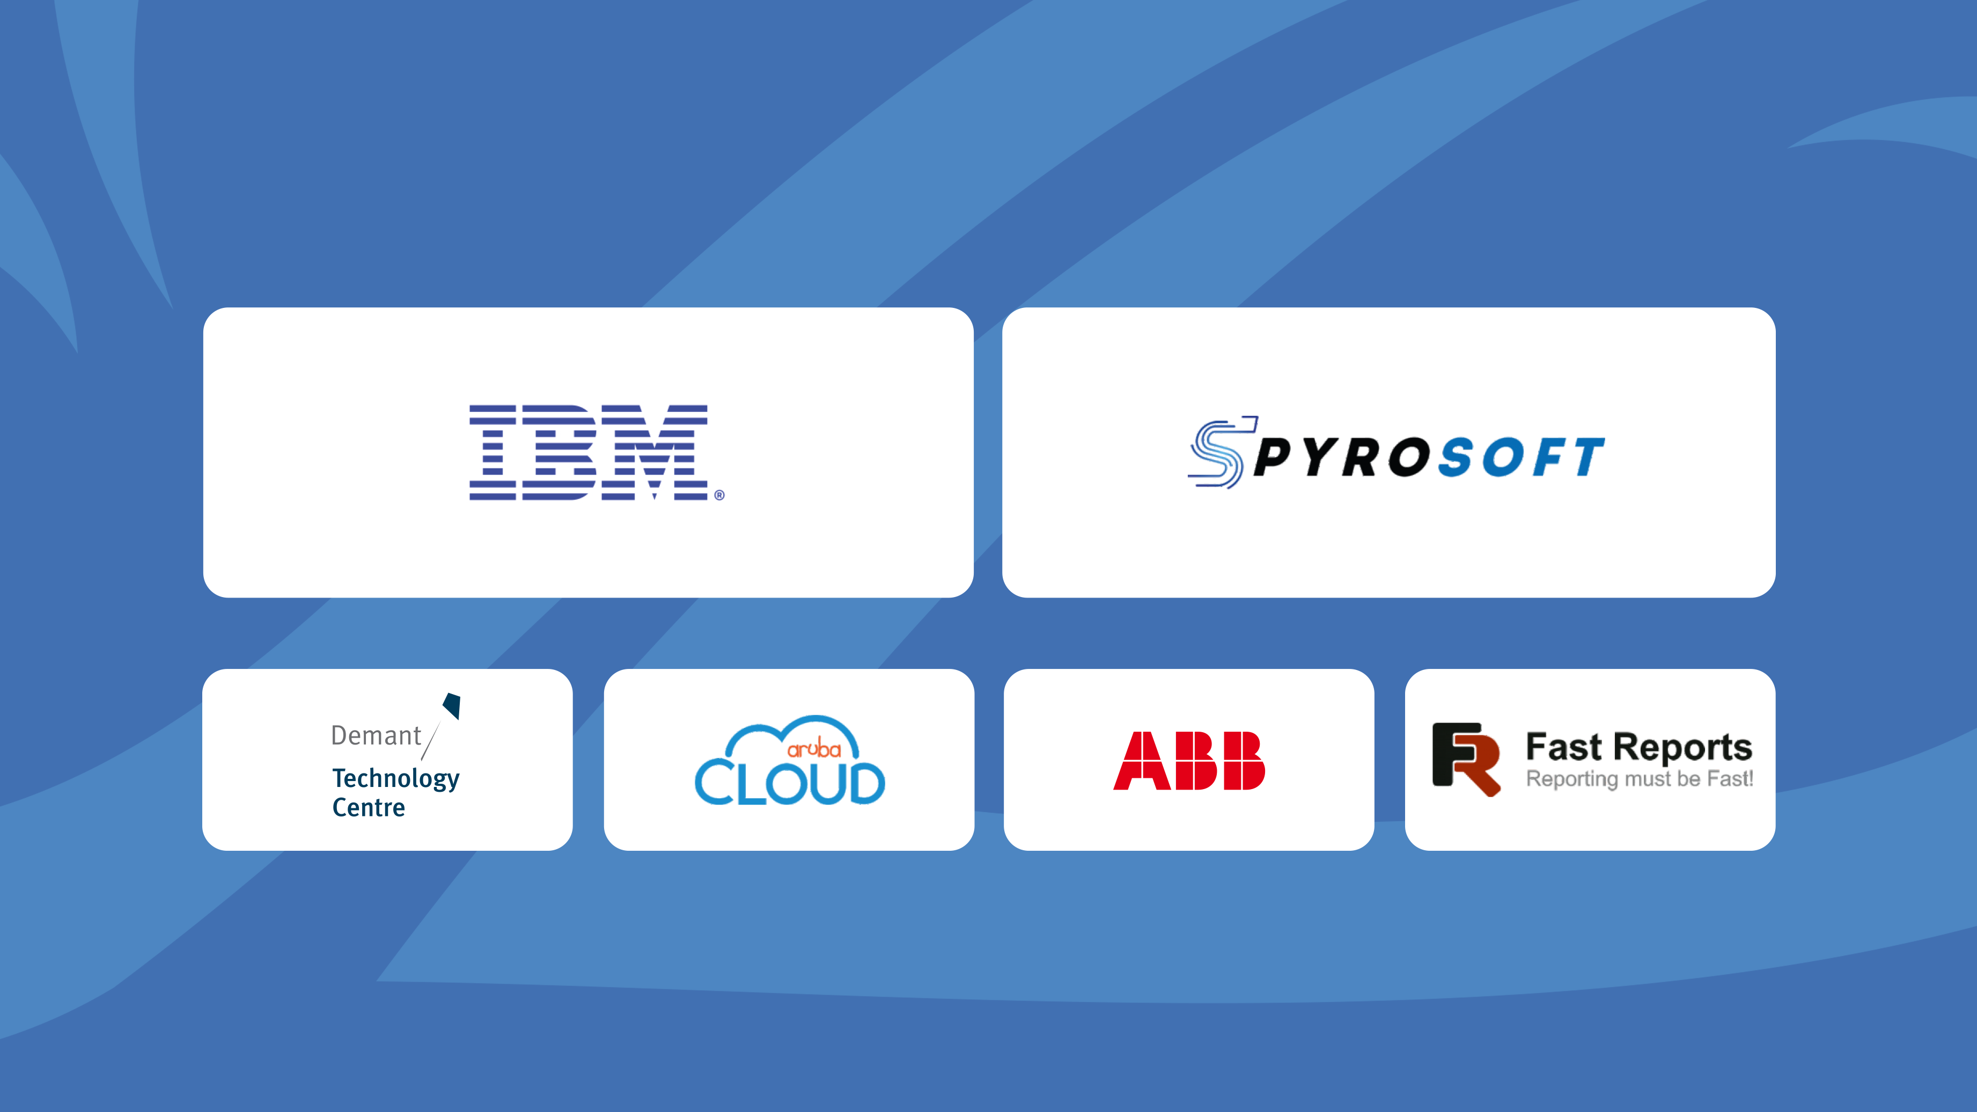
STRATEGIC SPONSORS
GOLD SPONSORS

Slide 3
API Gateways: Common Features
Reverse proxy – Routing
Logging, Monitoring and Analytics
Errors management
Documentation and API Portal
Traffic Management
Authentication
UI Composition / Aggregation
Transformation
API Lifecycle / environments
Caching and acceleration

Slide 4
API Gateways
Commercial products:
Apigee (Google)
Layer 7 (CA Api Gateway)
WSO2
MuleSoft
AWS API Gateway
Azure API Management
Axway
Open source alternatives

Slide 5
Ocelot
.NET Core API Gateway
https://github.com/ThreeMammals/Ocelot

Slide 6
Scenario
API Gateway
Storage
Customers API V1
Sales API V1
https://aw-api-customers.azurewebsites.net
https://aw-salesapi-2019.azurewebsites.net

Slide 7
Getting started
Scenario presentation and basic route-only implementation

Slide 8
Learned
Ocelot delivered as NuGet package
Needs:
«ocelot.json» configuration file
Basic declarations
Basic route
Redirection issues

Slide 9
Proxying APIs
Proxying Customers and Sales api with version-aware paths

Slide 10
Learned
Versioning with url prefix (alternatives?)
SSL termination is good
Routes can be overlapping (with priorities)

Slide 11
ViewModel composition
Aggregate requests and project the client-optimized model

Slide 12
Learned
Define dedicated paths for aggregation
Use custom aggregation functions
Minor fixes with headers transformation

Slide 13
Throttling
Traffic limiting under certain conditions

Slide 14
Learned
Very basic throttling features
Client-dependent feature (header)
Relate to Authorization header (with limitations)

Slide 15
Extension
Extend Ocelot from outside (without pull requests)

Slide 16
Learned
Simple DI-based configuration extension
Ocelot.Extensions.Configuration has minimal dependencies
And makes the API Gateway stateless
Not so easy to extend/modify the pipeline

Slide 17
Containerization
Azure App Service for Containers - PaaS

Slide 18
Staging/Production
Using the Gateway to discriminate environments

Slide 19
Learned
Integrated with fully-managed Container Registry
Shared, managed machine pool
Single or multiple container support (with limitations)
Integration of App Service with custom DNS
Ocelot host-header-based routing

Slide 20




API Gateway made easy with Ocelot and Containers
Roberto Freato – Consultant / Author / Solution Architect
https://www.robertofreato.com
https://github.com/childotg/Events.2019

Slide 21




Please rate this session using
Event Master
Mobile App
at the booth
in Lobby
login.developerdays.pl

Slide 22
STRATEGIC SPONSORS
GOLD SPONSORS

